Slide 1
Connect MT for the expansion of broadband internet access to Montana’s regions and locals that remain unserved or underserved

Slide 2
Agenda
1. Eligibility Overview
2. Technical Requirements
3. Financial Requirements
4. Challenge Process
5. FAQs

Slide 3
Eligibility Overview
Who:
Private Entities
Montana Nonprofits
Cooperatives
Partnerships
What:
Acquiring/installing middle or last mile broadband infrastructure
Where:
Frontier
Unserved
Underserved Areas

Slide 4
Applicant Eligibility Details
Must be enrolled as an Affordable Connectivity Program (ACP) Provider
Show evidence of Good Standing with Montana Secretary of State
Provide Federal Employer Identification Number
State of Montana Vendor Number

Slide 5
Cost Eligibility -- Details
Scalable to speeds of at least 100 Mbps
    Exceptions explained further in Section 6.5
Funds may not be used to support noncapital expenses,
    Including:
      general operations of an eligible provider
      nonbroadband services
      marketing or advertising
20% match required
Eligible Costs can only be incurred after the award contract is granted
    No pre-application expenses

Slide 6
Area Eligibility
Frontier: no or extremely limited access to terrestrial broadband services
Unserved: 10% with no access to broadband service at or above 25/10
Underserved: 10% with no access to broadband service at or above 100/20
RDOF areas are not eligible
The Proposed Project as a whole may serve non-eligible areas
Federal allocation funds can only be used for eligible areas.
Applicants will need to clearly delineate this in the application.

Slide 7
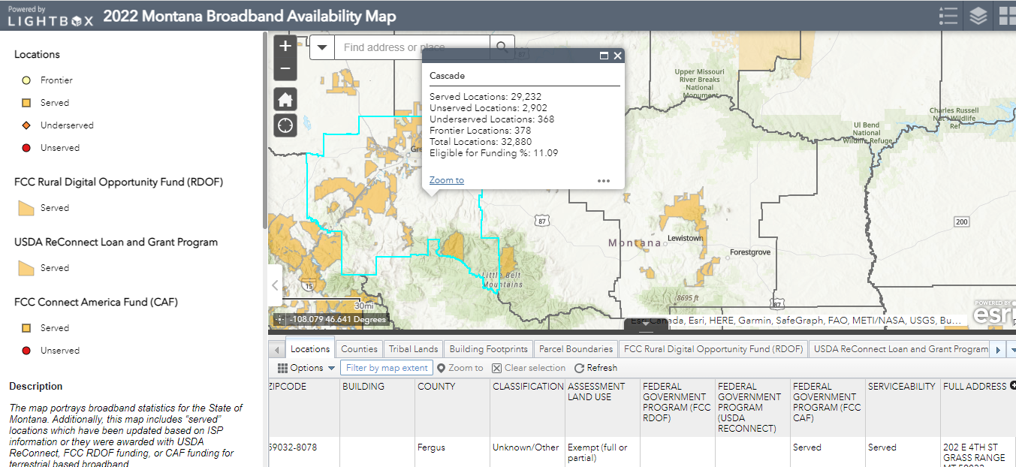
Connect Mt Map Overview

Slide 8
Technical Requirements Overview, 1 of 2
Technical Narrative
Preliminary Design Drawings (P.E. Stamped)
Notes:
Section 6.3 – I think Preliminary Design Drawings are the same as budgetary engineering designs.

Slide 9
PE Certification
Certified by a Montana PE
Montana Certified Professional Engineer
“This individual will be the primary contact for any technical questions regarding the allocation application document and supporting documentation. “
Name, Title, Telephone Number, Email Address
Notes:
Section 6.4

Slide 10
Technical Requirements Overview, 2 of 2
Material and Equipment Specifications
Logical Diagrams
Mapping
Notes:
Section 6.3

Slide 11
Capacity & Scalability
Does your solution provide 100Mbps/100Mbps?
Proposed solutions that do not meet this capacity threshold will require the following:
      Substantial narrative detailing the technical barriers to providing 100Mbps/100Mbps service
      Cost justification for the lower capacity service (on a per location basis)
      Identification of the steps required to upgrade the proposed solution to the desired 100Mbps/100Mbps service
Demonstrate Scalability to 100Mbps/100Mbps
Documentation must be provided to show the proposed solution provides 100Mbps/100Mbps on can be scaled to meet these speeds
This includes the appropriate specifications and narrative for the review team to assess
This documentation must be certified either by the equipment manufacturer or a registered Professional engineer

Slide 12
Permitting
Identify what permitting is required for the deployment of your project
Remember to make sure permitting timelines are accounted for in the presented project timelines
Environmental Compliance and MEPA Checklist
The checklist can be found on the forms and guides section of the website connectmt.mt.gov

Slide 13

Financial Requirements, 1 of 2
Balance Sheets, Income and Cash Flow Statements, or equivalents
Provide 3 years of unqualified historical financial statements
OR
2 years of unqualified comparative historical financial statements
  All historical financials must be CPA compiled, reviewed, or audited
Notes:
Section 6.7

Slide 14
Financial Requirements, 2 of 2
Pro Forma Requirements
Supplemental Information
Most recent year of federal tax returns
Independent audit
Proposed Budget
See Sample Budget Table
Notes:
Section 6.7

Slide 15
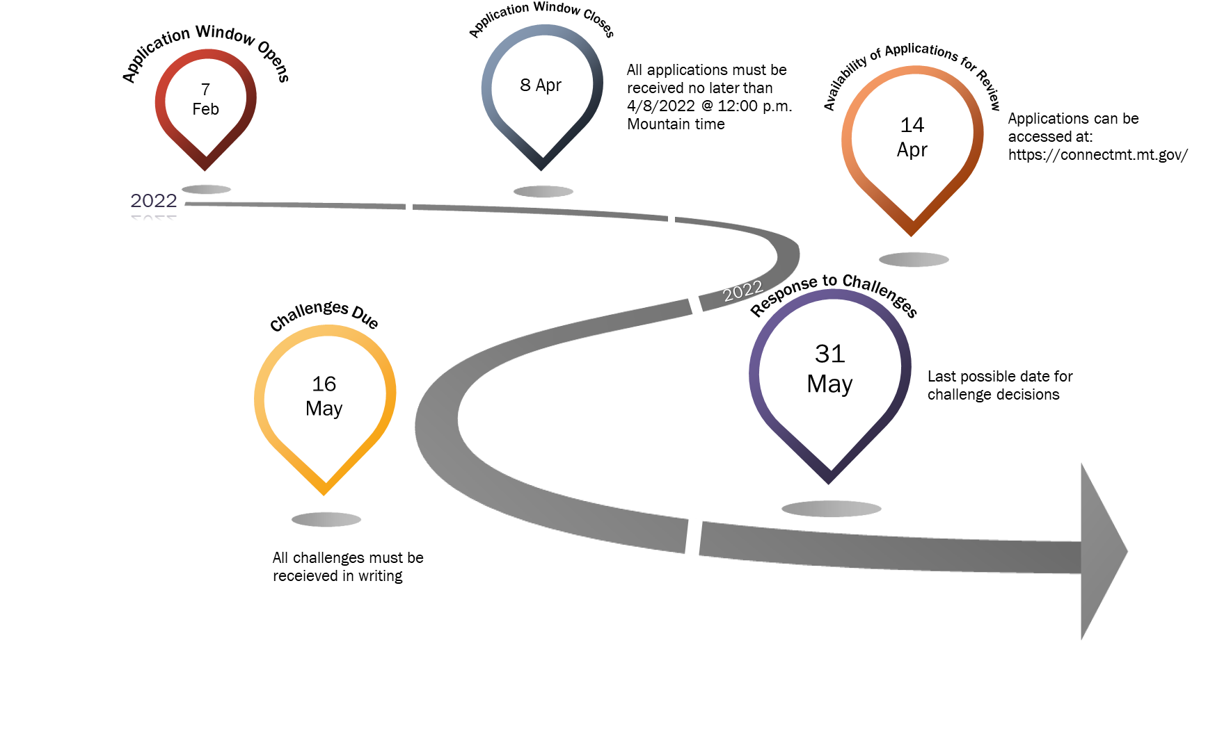
Challenge Process Overview
Notes:
Section 6.3

Slide 16
Questions?

