Slide 1
connectmt Broadband 101
Broadband 101
State Broadband Map
ConnectMT Program
Questions
Notes:
As you are already aware, the IIJA has several components to it regarding broadband. NTIA at the US Department of Commerce is covering the items that directly pertain to the state’s interaction with federal funding. The largest program is the BEAD program, which is where at least $100 million will be allocated to the state. In addition to this program , the state is eligible to apply for planning funding for digital inclusion and equity beyond the BEAD program. Both the BEAD Program and the Digital Equity Program require a state plan for bridging the digital divide. We don’t yet know what the final amount of funding is that each state will receive under the BEAD program. NTIA just had an Assistant Secretary confirmed, Alan Davidson. So many decisions that were delegated in statute will rest on his shoulders for implementation.

Slide 2
Broadband 101
Terminology
What is Broadband?
Fixed Broadband vs. Mobile Broadband
Served
Unserved
Underserved
Frontier
Last Mile
Middle Mile
Dark Fiber
FiberBroadbandAssocation_FiberGuide.pdf
Notes:
I will review the IIJA broadband timeline as we understand it today, followed by updates related to federal broadband funding from IIJA and a little review of the major funding mechanisms, including the NTIA, FCC, and USDA.

Slide 3
What is Broadband?
Advanced telecommunications capability = high-speed, switched, broadband that enables users to originate and receive high-quality voice, data, graphics, and video telecommunications using any technology.
FCC relies on single benchmark to analyze whether advanced service is deployed: SPEED
Speed = Bandwidth is a measure of how much data can be transferred from one point in a network to another within a specific amount of time. It’s typically used to measure how much data you can download to your device from a server on the internet.
Your actual bandwidth (Speed) will often be less than your maximum bandwidth due to network congestion, network overhead, and other external factors.
For instance, your internet connection may support a wide bandwidth (freeway) of 1,000 Mbps, but your internet plan may close a few lanes and limit your bandwidth to 400 Mbps. Add on network congestion, local cabling issues, and so on and your top bandwidth may only be 300 Mbps.
Latency, usage allowances, consistency not used
In broadband terminology, the word latency refers to how long it takes a request to travel from your device to another device over the internet. When you do something online, you make a request to another computer, basically saying “I would like this data, please”.

Slide 4
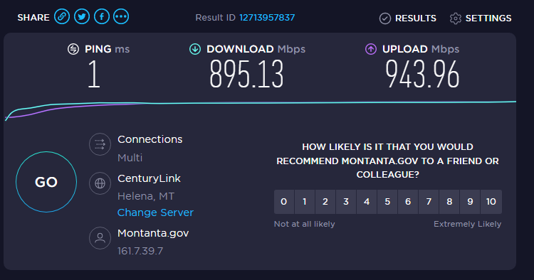
https://www.speedtest.net/

Slide 5
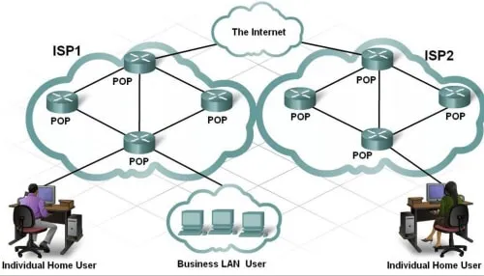
What is Broadband?
" middle mile " is the segment of a telecommunications network linking a network operator's core network to the local network plant, typically situated in the incumbent telco's central office, that provides access to the local loop, or in the case of cable television operators, the local cable modem termination system.
Last mile broadband access: Communications technology that bridges the transmission distance between the broadband service provider infrastructure (central office, point of presence, or internet exchange point) and the customer premises equipment.
Like Electricity: Power Generation and Transmission (to substation) vs. Distribution (substation to meter)

Slide 6
Access – Broadband Infrastructure and Availability
Broadband Access: What wireline and fixed wireless broadband services are available in your area?
Mobile Access: What cellular coverage and technology is available in your area?
Provider Engagement: Are there opportunities to further strengthen partnerships with existing and new service providers?
Public Assets: How do local policies support the use of public assets, enhance advanced telecommunications, and serve the public good?

Slide 7
Adoption – Digital Inclusion and Workforce Skills
Adoption and Use: Who is using the Internet? Are there digital divides?
Digital Inclusion: What proactive measures are you taking to ensure digital equity?
Digital Skills: Do programs provide a ladder for residents to gain digital proficiencies - from basics to coding?
Devices: Do people have access to the devices they need to learn, create and participate?

Slide 8
Community – Leadership and Context
Leadership: Who are the broadband champions in your locality?
Community Priorities: What issues draw us to take action to improve broadband?
Stakeholder Engagement: How are you engaging stakeholders that can bring interest, influence, or support to local broadband initiatives?
Policy Environment: Are there regional or state resources or regulations that impact local planning and investment?

Slide 9
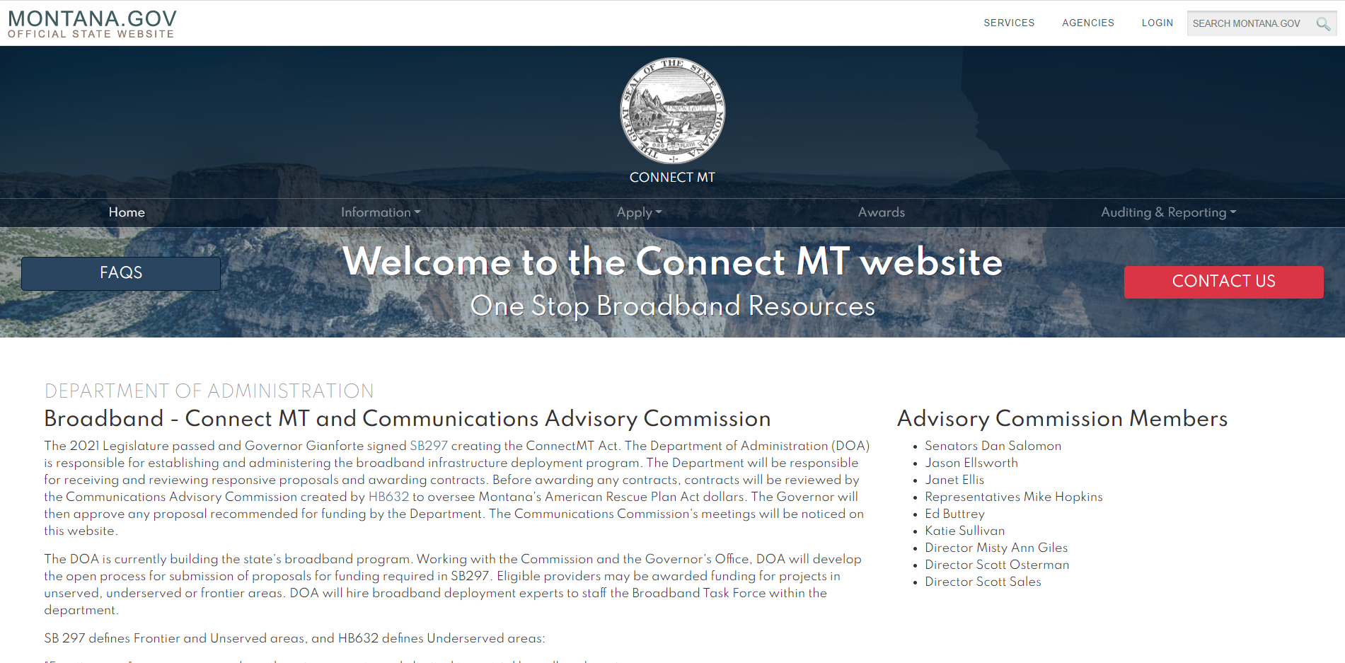
ConnectMT Website Orientation
https://connectmt.mt.gov/
Website includes:
FAQs
Information about the statewide broadband map, federal resources, announcements, events, webinars, forms, and guides
Application link and guidance
Project challenge process
Awards
Auditing and reporting
Contact information

Slide 10
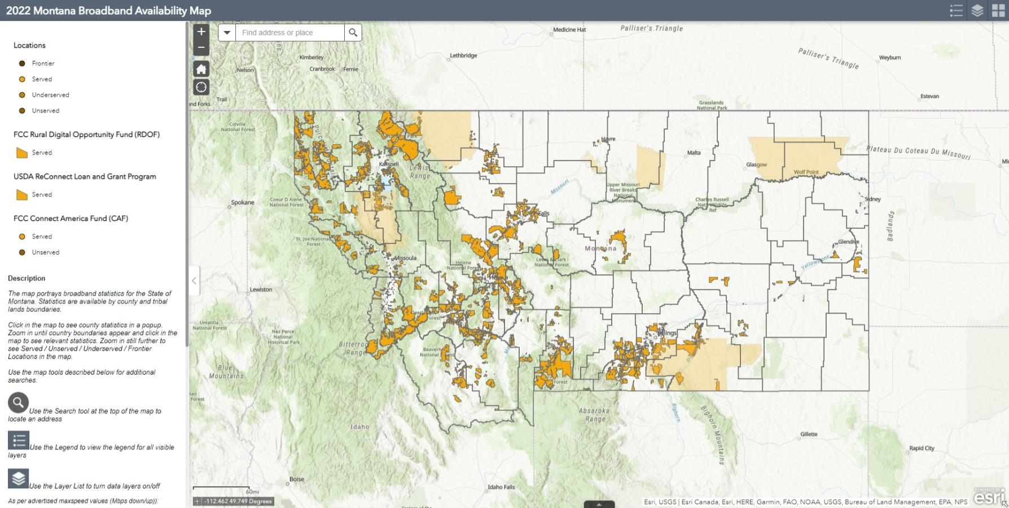

Slide 11
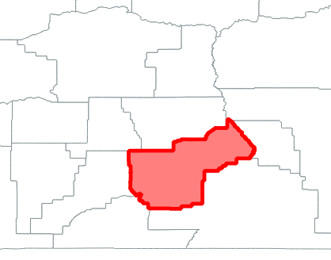
Boundary Snapshot Example
County | Yellowstone
Served | 65,789
Unserved | 4,279
Underserved | 3,469
Frontier | 347
Total | 73,884
Eligible % | 11%
Notes:
As part of the map experience – a user can select a county to understand the broadband serviceability statistics and the number of locations from served to frontier.
The eligible % presents the total number of locations that are eligible for funding and are either unserved, underserved or frontier as our benchmark target for the state is to get as many houses as possible to the standard of 100/20 or better.

Slide 12
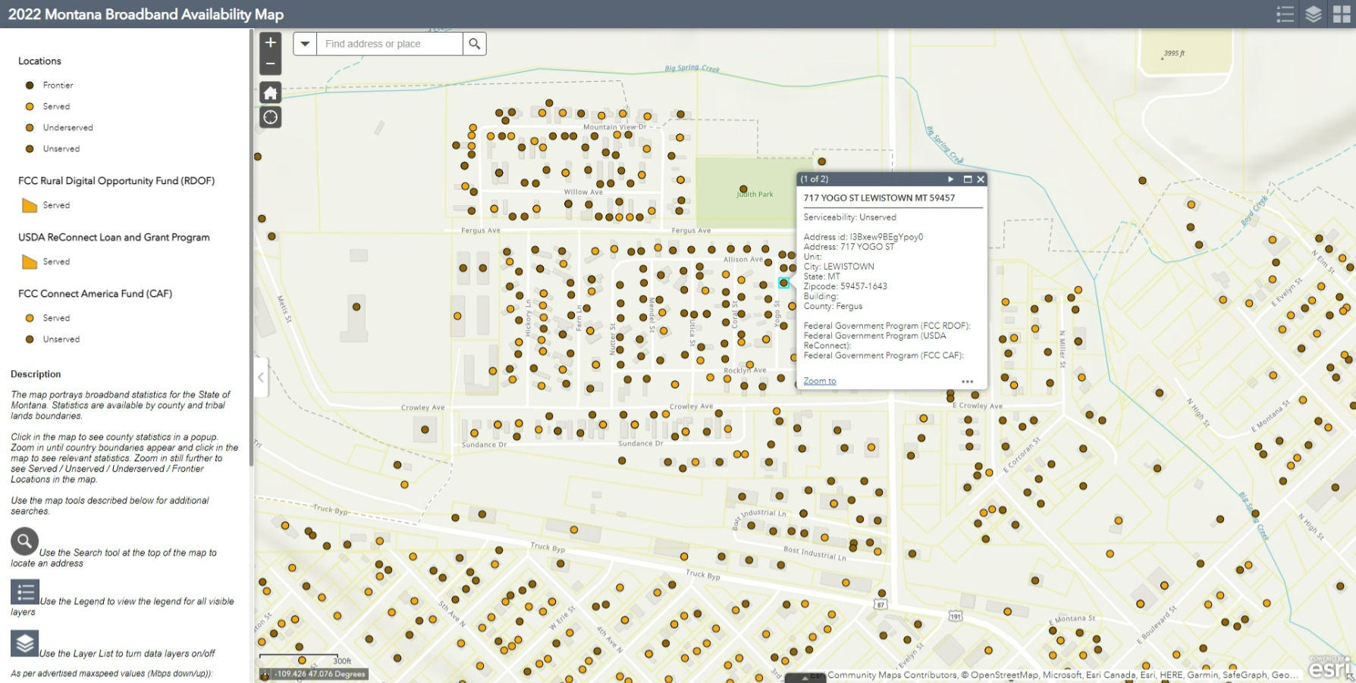

Slide 13
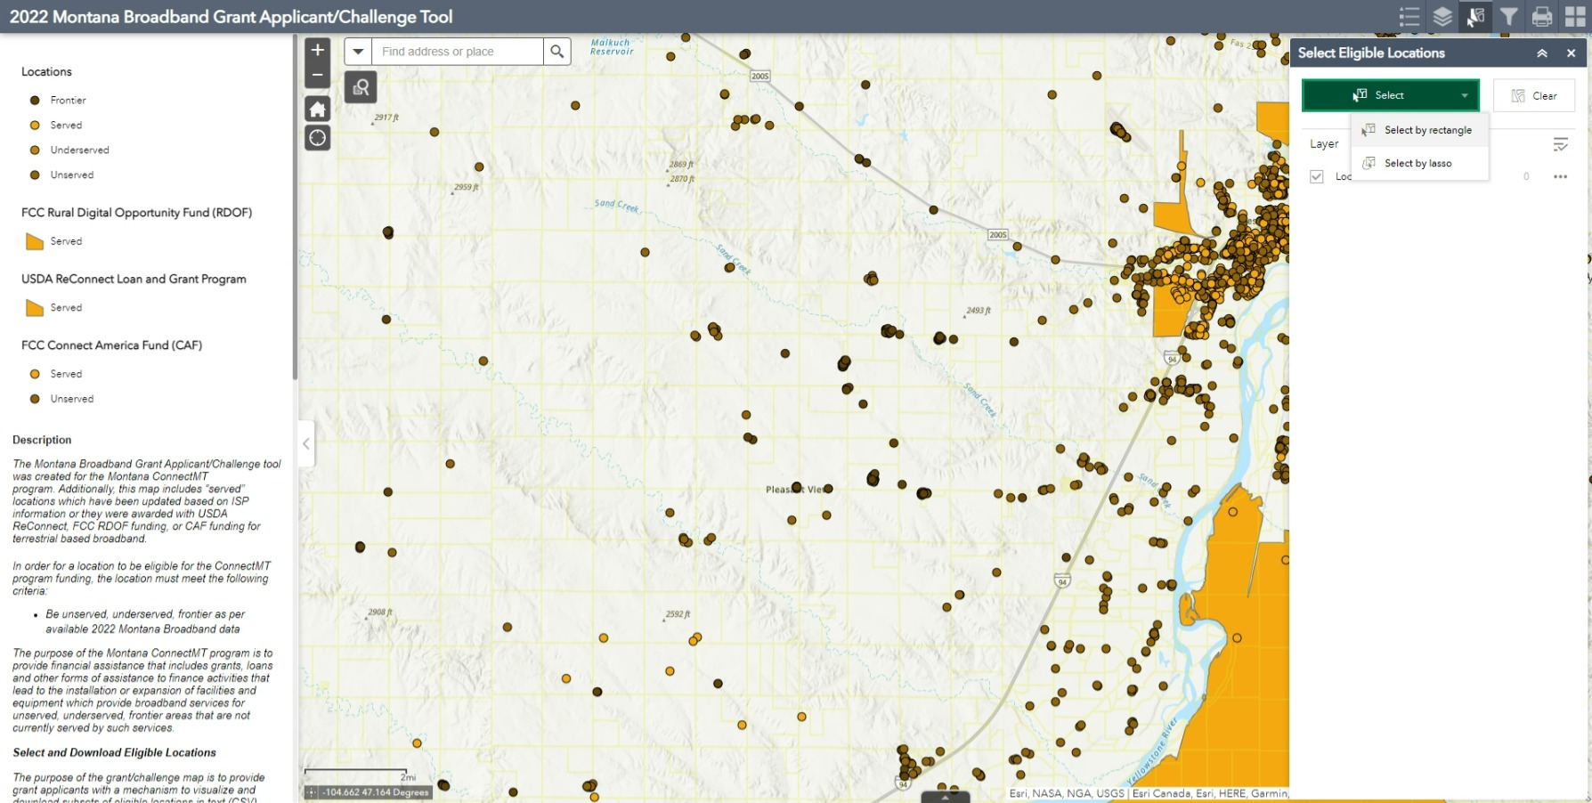

Slide 14
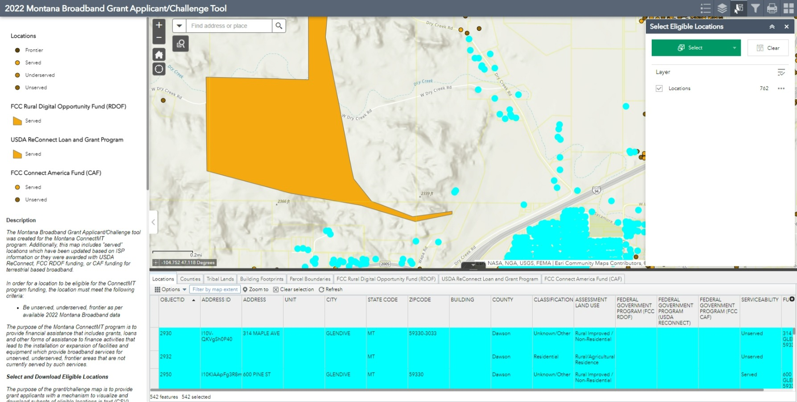

Slide 15
Application Timeline Update
2/7/22-4/8/22 Statewide Application window
2/10/22 Application Webinar
4/13/22 Applications available for public review
4/14/22-5/12/22 30 day Challenge period
5/27/22 DOA responses to challenges
5/30/2022-6/3/22 Applicants open to modify applications
June 2022 Receive ARPA funds from US Treasury
6/4/22 – 6/30/22 Review eligible applications & determine awards
6/30/22 Obligate and announce awards
Notes:
We plan to open the application window shortly after the statewide map is published. The application window will open February 7th, and remain open for 60 days. This will be followed by the 30 challenge period, the 15 response period, a 5 day modification period and then our review timeframe that culminates on June 30th for award determinations.

